Slide 1

Analyzing U.S. Crime Data

Slide 2
TABLE OF CONTENTS
Data Collection and Cleaning
Exploratory Analysis
Answering Questions
Hypothesis Testing
Regression Analysis
Bonus Task

Slide 3

01.
Data Collection and Cleaning

Slide 4
DDL APIs was used to get most of the datasets using wget() and gdown() libraries.
Data cleaning was done generally by known methods,and some modifications for each stage separately depending on needs.
Label to values transformation depending on codebook and label encoding was done for textual datasets.

Slide 5
02.
Exploratory Analysis

Slide 6
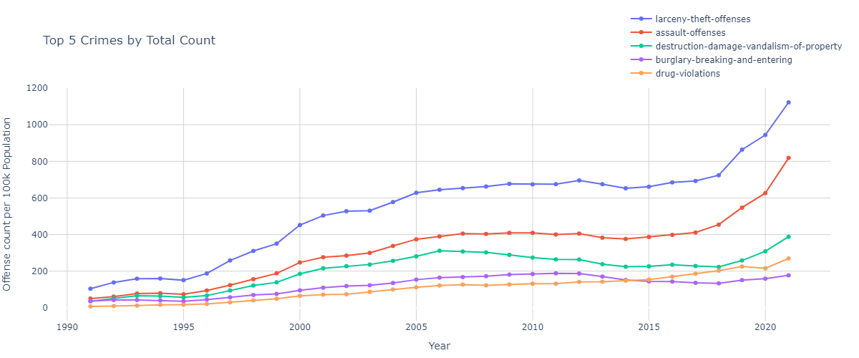
Larceny-Theft-Offenses are the top offenses all over the years.
Reasons: It’s easiest type of crime

Slide 7
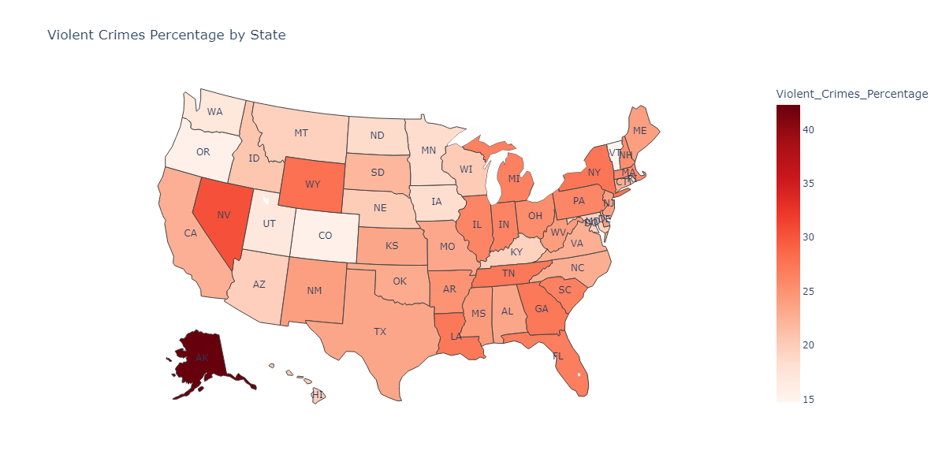
Reasons:
- Many Heavy drinkers in the state
- Considerable distances between locations
Alaska has the highest rate in violent crimes.

Slide 8
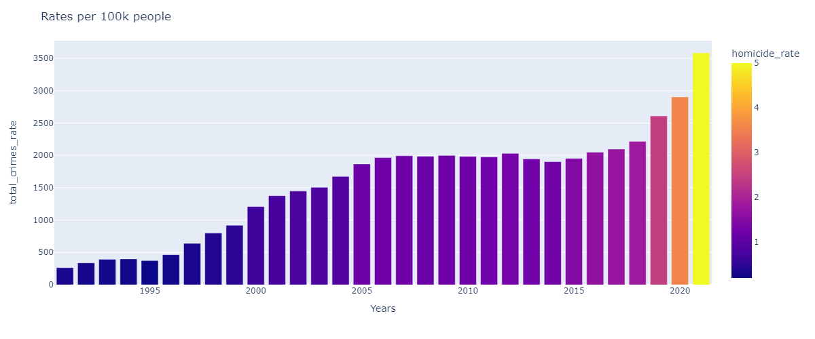
Homicide rates have increased rapidly over the last 3 years.
Reasons for that:
Pandemic stress - The civic upheaval that followed George Floyd's murder
Crime rates in the period of 1991 to 1996 are relatively small.
The reasons for that is: Economic Expansion

Slide 9
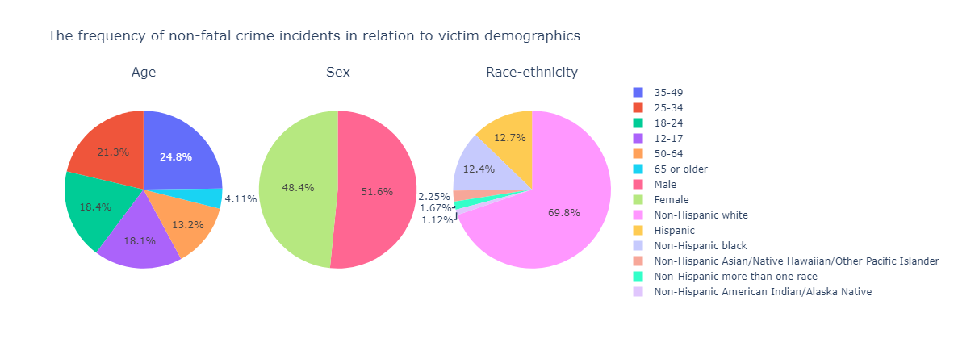
Q4
Of all victims of non-fatal crimes who suffer an injury, which demographic is the most likely to receive medical attention at the scene? Which is the least likely?

Slide 10
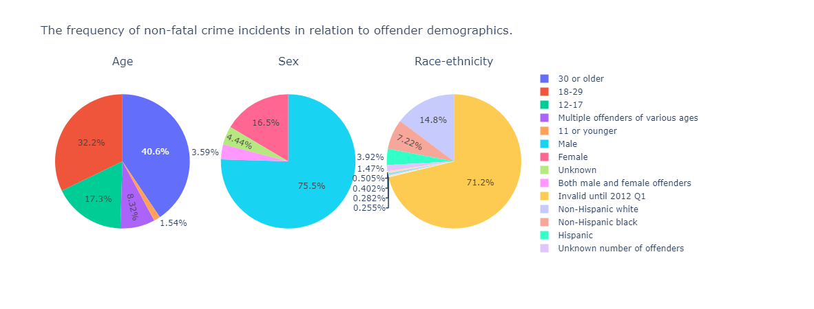
Q5
Which class of crimes is associated with the highest rate of same-offense-recidivism; i.e. prison re-entry for the same offense within 3 years of release?

Slide 11
03.
Answering Questions

Slide 12
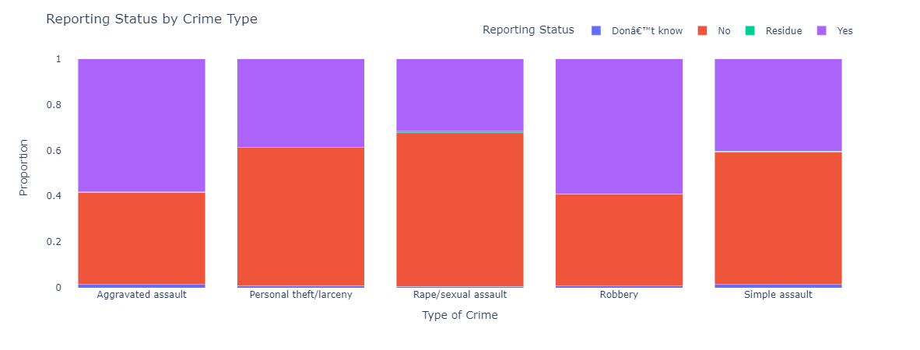
Q1: Which type of non-fatal crime is the most under-reported?

Slide 13
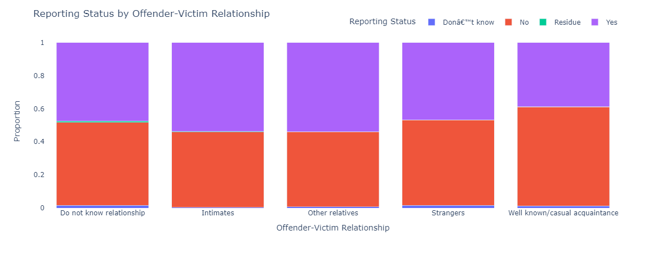
Q1: Is there an association between the offender-victim relationship and the likelihood of a crime being reported?

Slide 14
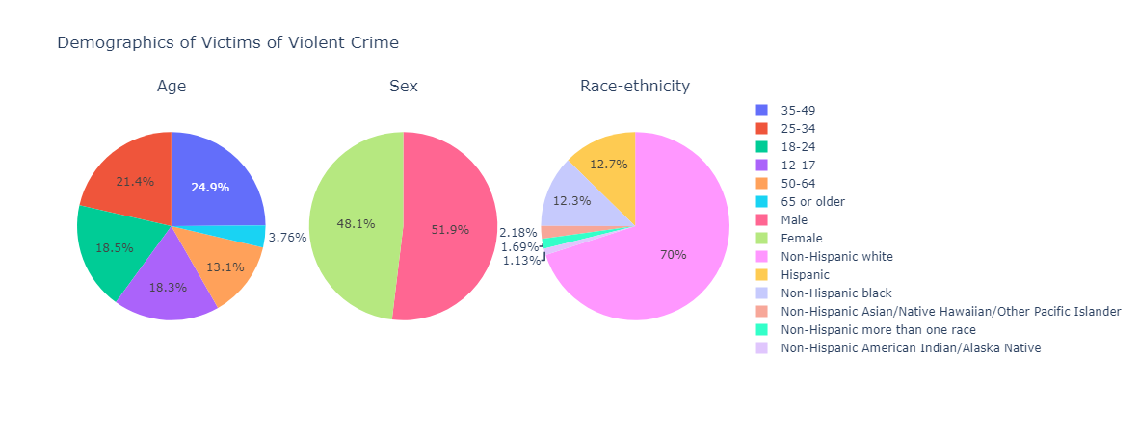
Q2
Who are the people (the demographic segment) that appear to be most at risk of violent victimization? Who is the least at risk?

Slide 15
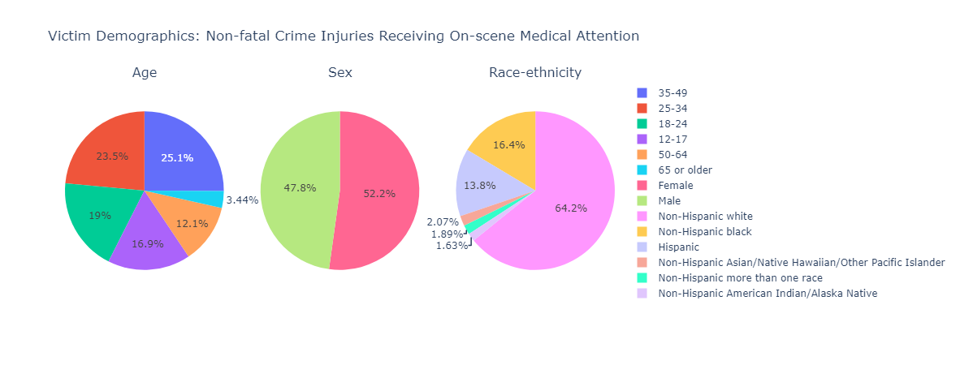
Q3
Of all victims of non-fatal crimes who suffer an injury, which demographic is the most likely to receive medical attention at the scene? Which is the least likely?

Slide 16
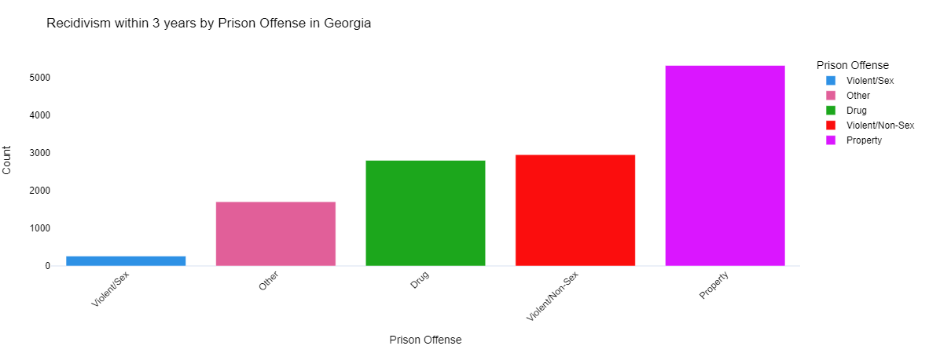
Q4
Which class of crimes is associated with the highest rate of same-offense-recidivism; i.e. prison re-entry for the same offense within 3 years of release?

Slide 17
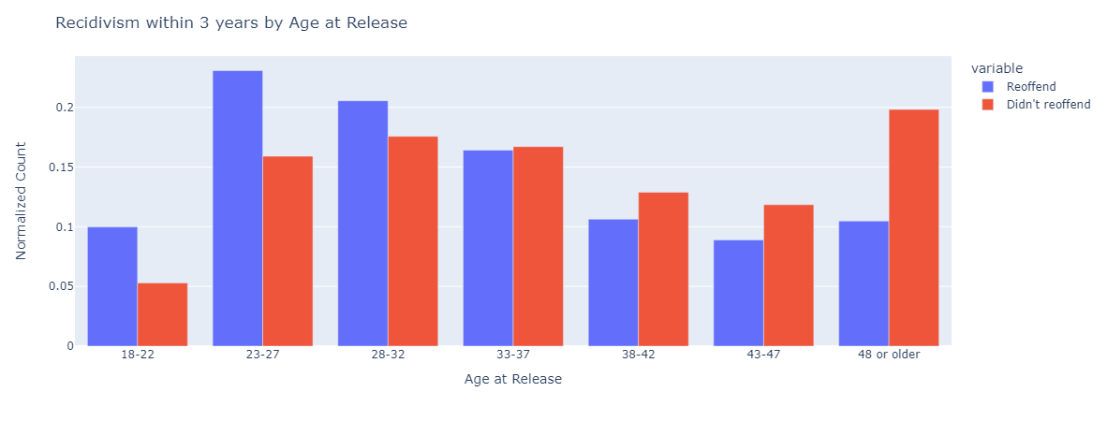
Q5
Are prisoners who are younger at the time of release more or less likely to reoffend than those who are older?

Slide 18
04.
Hypothesis Testing

Slide 19
The hypothesis being tested is:
"U.S. states that implement stricter firearm control laws have lower violent crime rates on average."

Slide 20
Analysis Methodology
Data Extraction:
Relevant data for the last 10 years (2010-2020) was extracted from two datasets:
fire_lawsdf: Information about firearm control laws
offensecountdf: Information about offense counts
Data was extracted for each year from 2010 to 2020.
Hypothesis Testing:
A t-test was performed to compare offense counts between states with stricter firearm control laws and those with less strict laws over the last 10 years.
The p-value obtained from the t-test was used to determine the significance of the relationship between firearm control laws and violent crime rates.

Slide 21
Results
P-value for the Last 10 Years: 0.383
The obtained p-value suggests that there isn't strong statistical evidence to reject the null hypothesis over the last 10 years.
Thus, there isn't sufficient evidence to support the claim that U.S. states with stricter firearm control laws have lower violent crime rates on average over this period.

Slide 22
05.
Regression Analysis

Slide 23
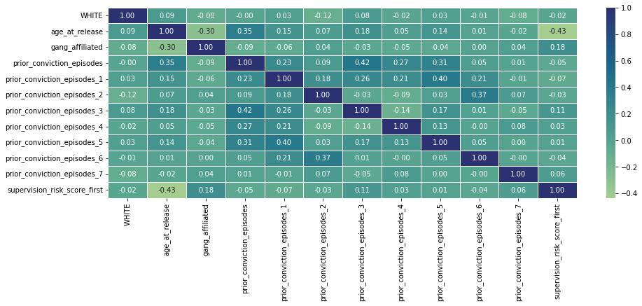

Slide 24
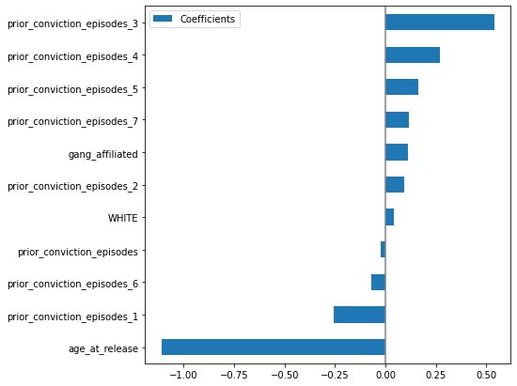
Training R2: 0.24870531231493
Test R2: 0.24401992046393

Slide 25
06.
Bonus Task

Slide 26
 | Best Parameters | Training Accuracy | Test Accuracy
Model 1 [PCA with Random Forest] | - PCA Components: 20 - Random Forest Estimators: 100 - Random Forest Min Samples Split: 5 - Random Forest Max Depth: 30 | 99.96% | 97.12%
Model 2 [PCA with Gradient Boosting] | - PCA Components: 20 - Gradient Boosting Estimators: 5 - Gradient Boosting Max Depth: 20 | 98.51% | 92.55%
Model 3 [UMAP with Random Forest] | - UMAP Components: 20 - UMAP Neighbors: 30 - Random Forest Min Samples Split: 2 - Random Forest Max Depth: 20 | 100% | 93.28%

Slide 27
THANKS :)

